Slide 1
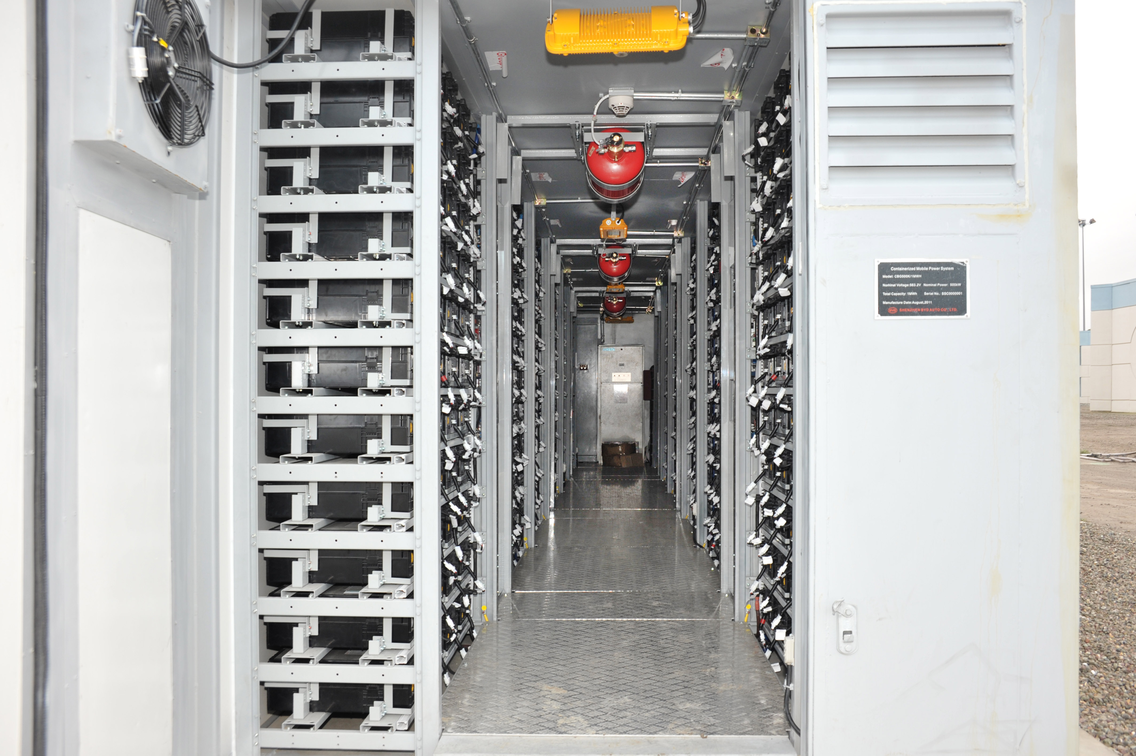
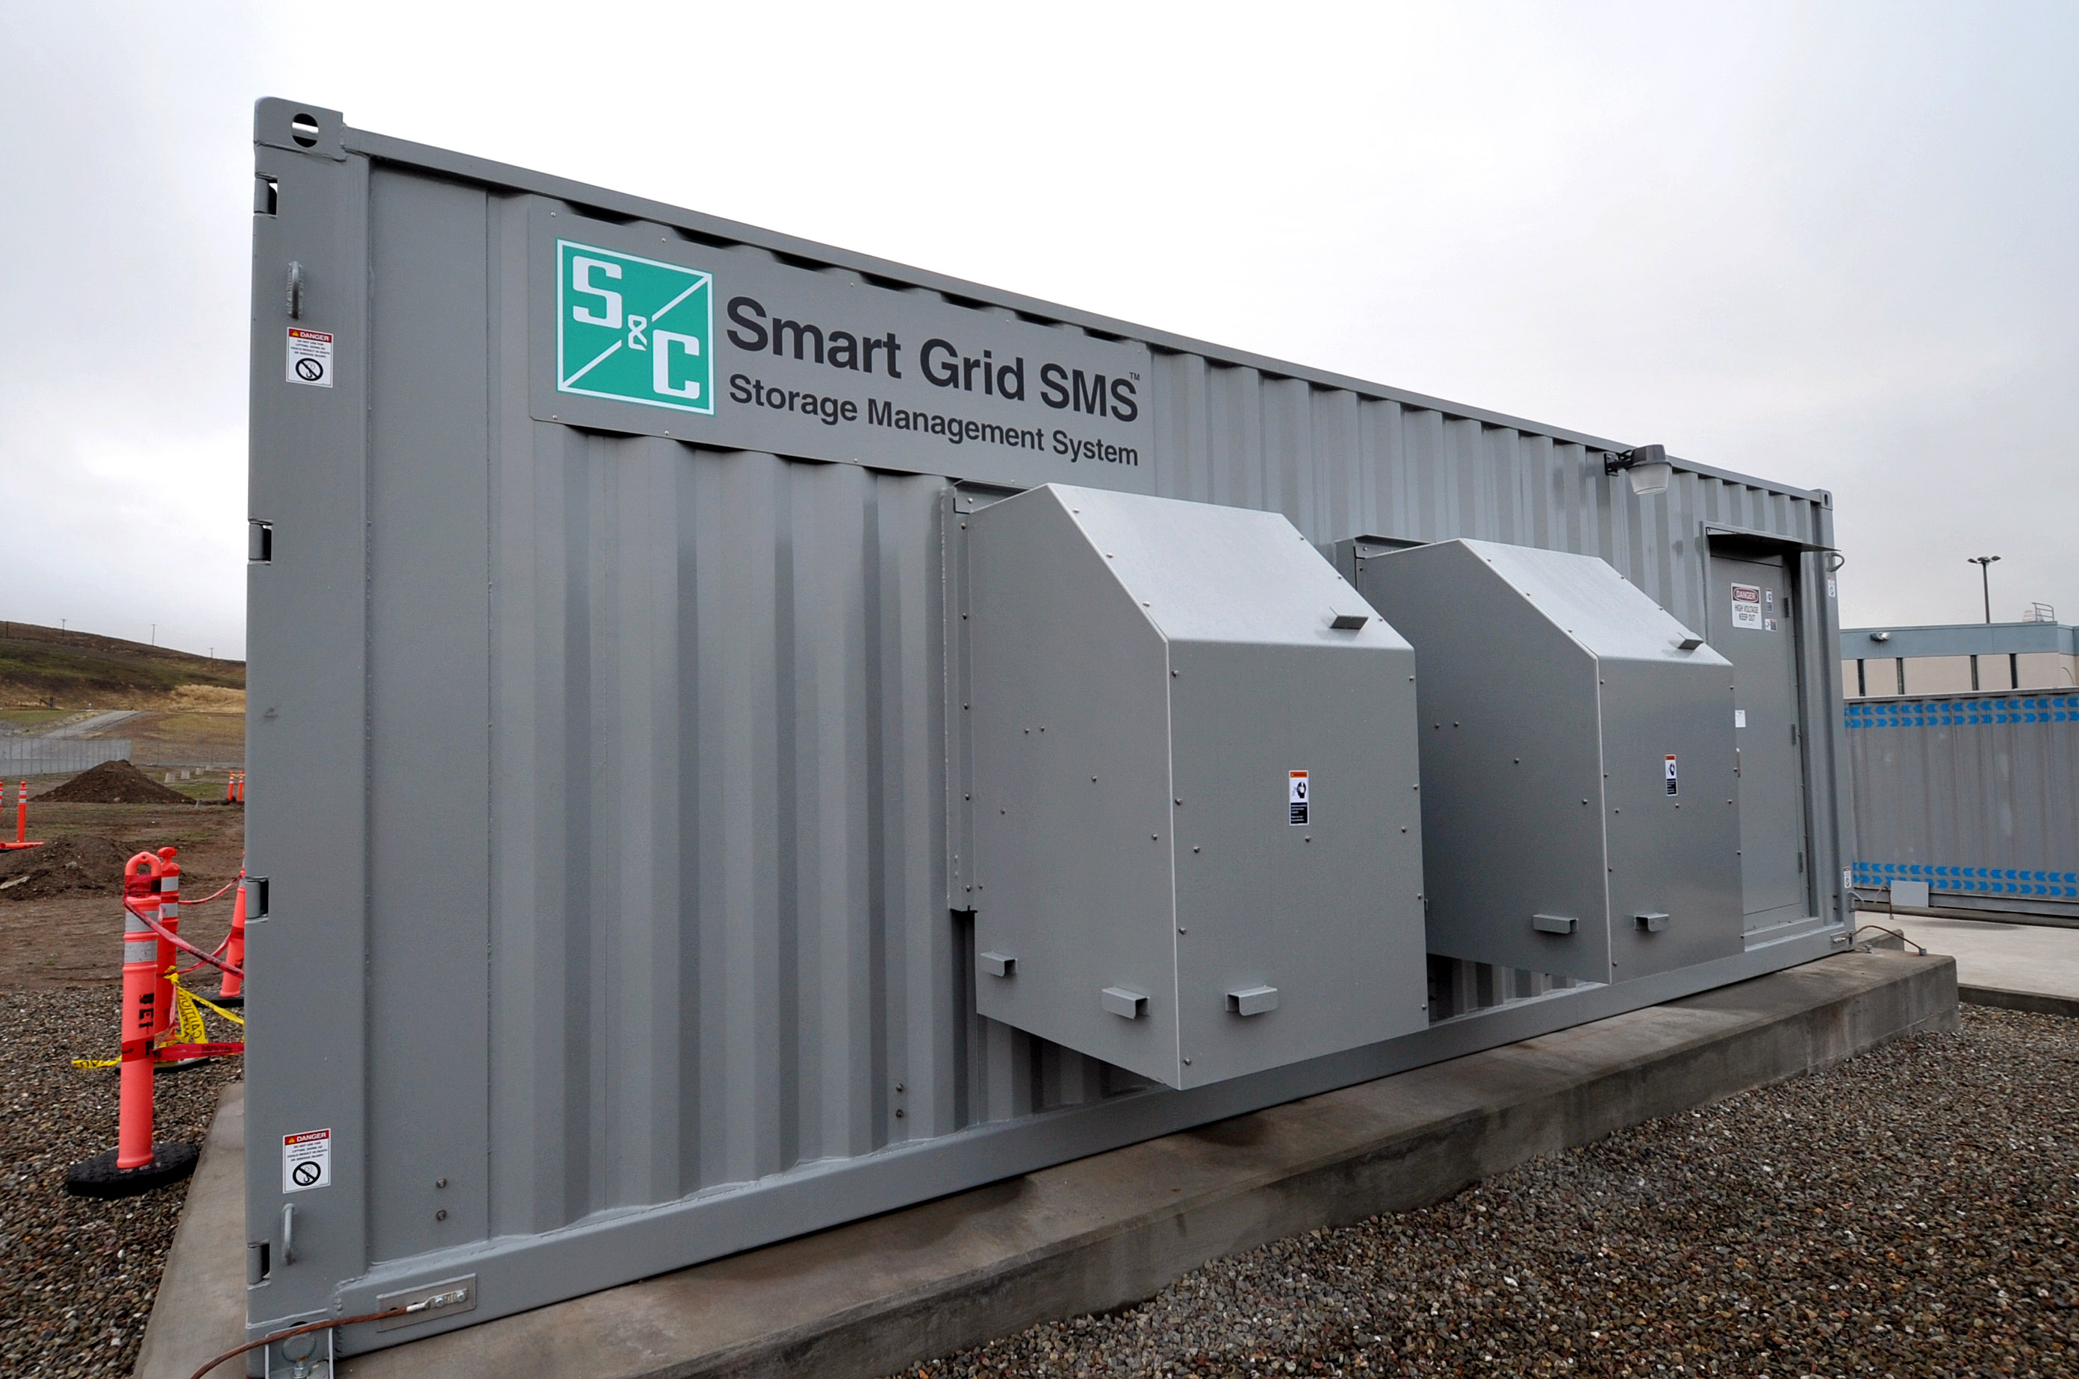
2 MW/ 4MW-hr
Storage system
SRJ 2012
Technical Challenges of high level of inverter-based resources in Power System
NSF Workshop on Power Electronics-enabled
Operation of Power Systems
31 October 2019
Bob Lasseter
University of Wisconsin- Madison
Notes:
Example of DER describe: Fuel cell, PV large battery
DER penetration
1000 10,000 or more how do we handle, control ?
Are they a problem or can they bring value?
Cluster in to a microgrid

Slide 2
High level of inverter-based resources
California ~50% Peak Wind & PV Instant. Penetration
Texas ~55% Peak Wind Instant. Penetration
Hawaii Island ~70% Peak PV Instantaneous Penetration
Total system load
Load tripping
Hawaiian island of Oahu
(50% distributed PV)
M. Elkhatib, R. Lasseter, Wei Du, “Evaluation of Inverter-based Grid Frequency Support using Frequency-Watt and Grid-Forming PV Inverters,” IEEE PES 2018

Slide 3
“Loss of inertia in power system”
Frequency (Hz)
Time(s)
Grid-following
(Frequency-Watt)
Time(s)
5% loss of load

Slide 4
Loss of inertia??
Frequency (Hz)
Time(s)
Grid-following
Time(s)
Frequency (Hz)
Time(s)
Grid-forming
Time(s)

Slide 5
Inverter control
Grid Following Control (GFL)
Frequency is measured; Control P & Q
Controls Real & Reactive power
Frequency-Watt Function (grid support)
Dependent on utility for voltage No direct control of frequency Re-dispatch for load changes
Grid Forming Control (GFM)
P & Q is measured; Control Voltage & Frequency
Controls Voltage and Frequency
Droop Control (Autonomous power sharing)
No direct control of current No direct control of Q

Slide 6
High level of inverter-based resources
  Major Questions
  Large turbine - Inverter dynamics?
  How do you control hundreds of thousands to millions of inverters?

Slide 7
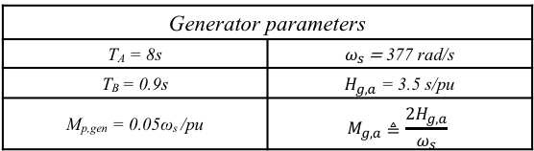
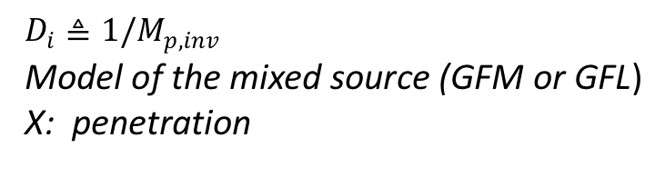
Turbine - Inverter dynamics
$D_{i}≜1/M_{p,inv}$
Model of the mixed source (GFM or GFL)
X: penetration
Generator parameters
T_{A} = 8s | $ω_{s}$ = 377 rad/s
T_{B} = 0.9s | $H_{g,a}$ = 3.5 s/pu
M_{p,gen} = 0.05ω_{s} /pu | $$M_{g,a}≜\frac{2H_{g,a}}{ω_{s}}$$
GFL parameters
M_{p,inv} = 0.05ω_{s} /pu
T_{L} = 0.5s
GFM parameters
M_{p,inv} = 0.05ω_{s} /pu
T_{M} = 7.96 ms

Slide 8
GFM Inverters Increases Damping in Power System

Slide 9
High level of inverter-based resources
  Major Questions
  Large turbine - Inverter dynamics?
  How do you control hundreds of thousands to millions of inverters?
  Autonomous frequency stabilization
  Autonomous relief of overloaded GFM inverters
  Implementation of GFM PV systems with autonomous reserves

Slide 10

Grid-forming Inverters
Autonomous Power sharing
$${\begin{aligned} \\ ∆P_{i}=P\end{aligned}}_{L}\frac{{xm}_{G}}{(1−x)m_{i}+{xm}_{G}} → \frac{P_{L}}{2} for x=\frac{1}{2} m_{i}=m_{G}$$
Overload
  A1 near rating so that A1 + $∆P_{i}$ > rating
A1
A2

Slide 11
Overload
Change the phase angle
between sources: Δδ
A1
A2

Slide 12
Overload Transfer
Change the phase angle
between sources: Δδ
A1
A2

Slide 13
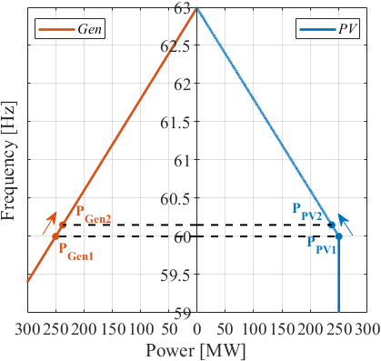
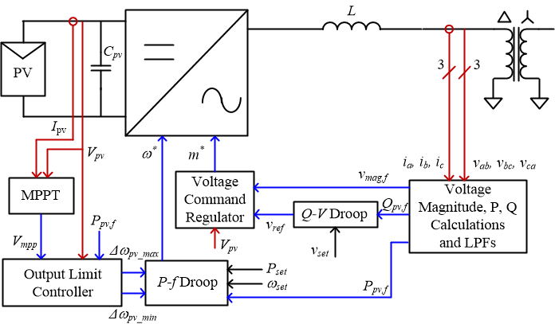
PV- Inverter and Turbine
Loss of load
G
P_{max} = MPP

Slide 14
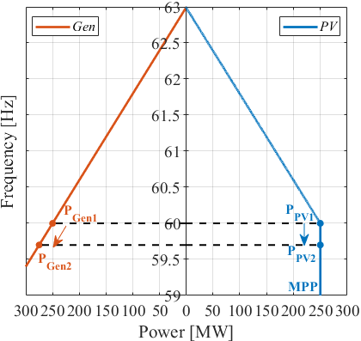
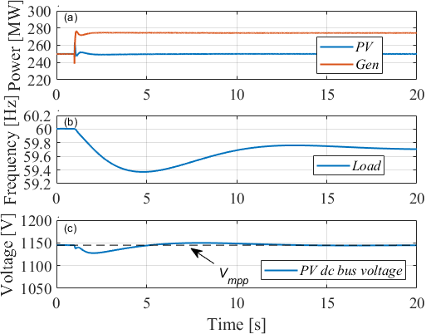
PV- Inverter and Turbine
Loss of 25 MW
G

Slide 15
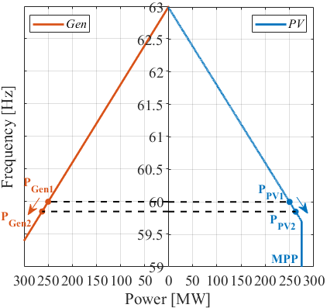
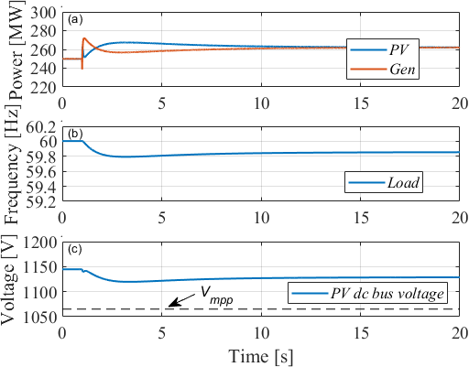
PV- Inverter and Turbine
with Reserves

Slide 16
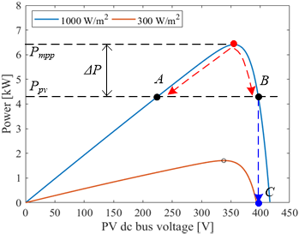
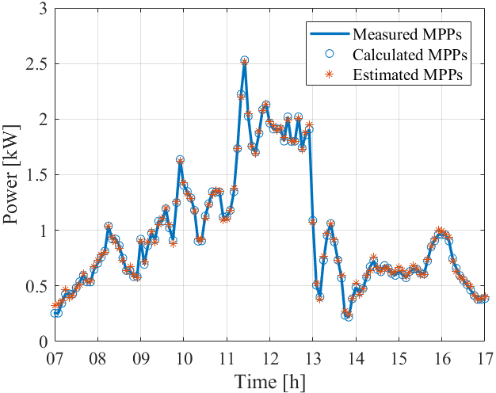
Estimate MPP voltage
to provide Reserves
Reserve
Actual PV MPP vs. Estimation of MPP

Slide 17
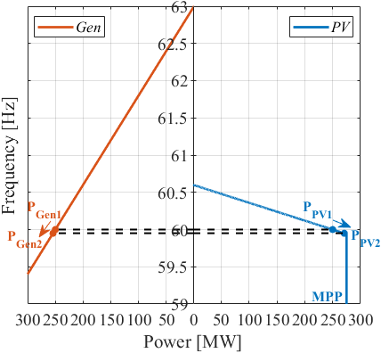
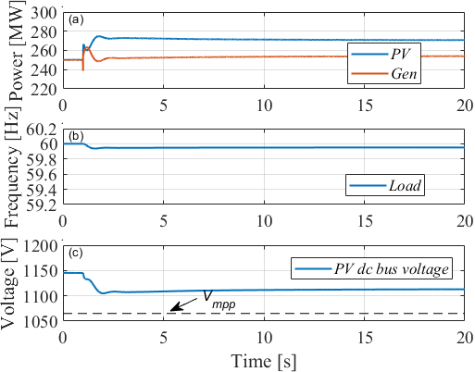
Load Sharing
Different droops
$${\begin{aligned} \\ ∆P_{i}=P\end{aligned}}_{L}\frac{{xm}_{G}}{(1−x)m_{i}+{xm}_{G}} → \frac{5}{6}P_{L} for x=0.5 m_{i}={0.01 m}_{G}=0.05$$

Slide 18
Research Questions
Over load protection for thousands of GFM inverters
Use of different droops in the distribution system
Voltage stability and reactive power flow
Modeling and simulation tools
System protection
Inverter fault ride-through
Allocation and data for inverter reserves

