Slide 1
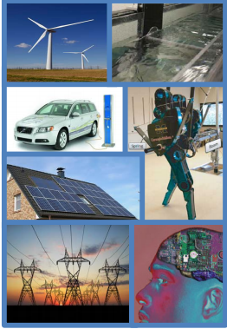
NSF Perspectives:
Challenges and Opportunities
Anil Pahwa, Alireza Khaligh, Kishan Baheti, Tony Kuh
Energy, Power, Controls and Networks (EPCN)
National Science Foundation
NSF Workshop on Power Electronics-enabled Operation of Power Systems
October 31 – November 1, 2019
Illinois Institute of Technology, Chicago

Slide 2
Outline
Introduction – History and present status
ECCS Organization
EPCN Focus
Multi-directorate Programs
NSF “10 Big Ideas”
Workshop Expectations

Slide 3
1950: The Founding Act
On 10 May 1950, President Truman signed Public Law 81-507.
[PUBLIC LAW 507-81ST CONGRESS]
[CHAPTER 171-2D SESSION]
[S. 247]
AN ACT
To promote the progress of science; to advance the national health, prosperity, and welfare; to secure the national defense; and for other purposes.
Be it enacted by the Senate and House of Representatives of the United States of America in Congress assembled, That this Act may be cited as the "National Science Foundation Act of 1950".
ESTABLISHMENT OF NATIONAL SCIENCE FOUNDATION
SEC. 2. There is hereby established in the executive branch of the Government an independent agency to be known as the National Science Foundation (hereinafter referred to as the “Foundation”). The Foundation shall consist of a National Science Board (hereinafter referred to as the "Board") and a Director.
Notes:
The Act begins with these words: “An act to promote the progress of science; to advance the national health, prosperity, and welfare; to secure the national defense; and for other purposes.” Those last words are a signpost to the frontier—“and for other purposes”—acknowledging the truth of basic research, that knowledge will expand the possible. Bush’s frontier was a place where exploration of the unknown would improve people’s lives, making our country wealthier, healthier, and more secure in every way—and in new ways.

Slide 4
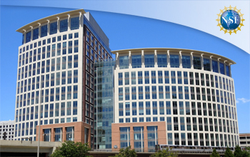
NSF Strategic Plan
VISION – A Nation that is the global leader in
research and innovation
MISSION – To promote the progress of science, to advance the national health, prosperity, and welfare; to secure the national defense; and for other purposes
VALUES – Excellence, Public Service, Learning, Inclusion, Collaboration, Integrity, Transparency
NSF will celebrate its 70th anniversary in 2020.
https://www.nsf.gov/about/performance/strategic_plan.jsp
Notes:
NSF envisions a national that is the global leader in research & innovation
Our mission is very broad – covering basic research in just about anything – and has been the same since we were established in 1950
BTW, NSF will celebrate its 70th anniversary next year, and we have some exciting things in store to celebrate.
Watch our website or social media for further details.
Goal: Expand knowledge in science, engineering, and learning
Objectives:
Advance knowledge through investments in ideas, people, and infrastructure.
Advance the practice of research
Goal: Advance the capability of the Nation to meet current and future challenges
Objectives:
Support research and promote _{partnerships} to accelerate innovation and to provide new capabilities to meet pressing societal needs
Foster the growth of a more capable and diverse research workforce and advance the scientific and innovation skills of the Nation
Goal: Enhance NSF’s performance of its mission
Objectives:
Attract, retain and empower a talented and diverse workforce
Continually improve agency operations

Slide 5
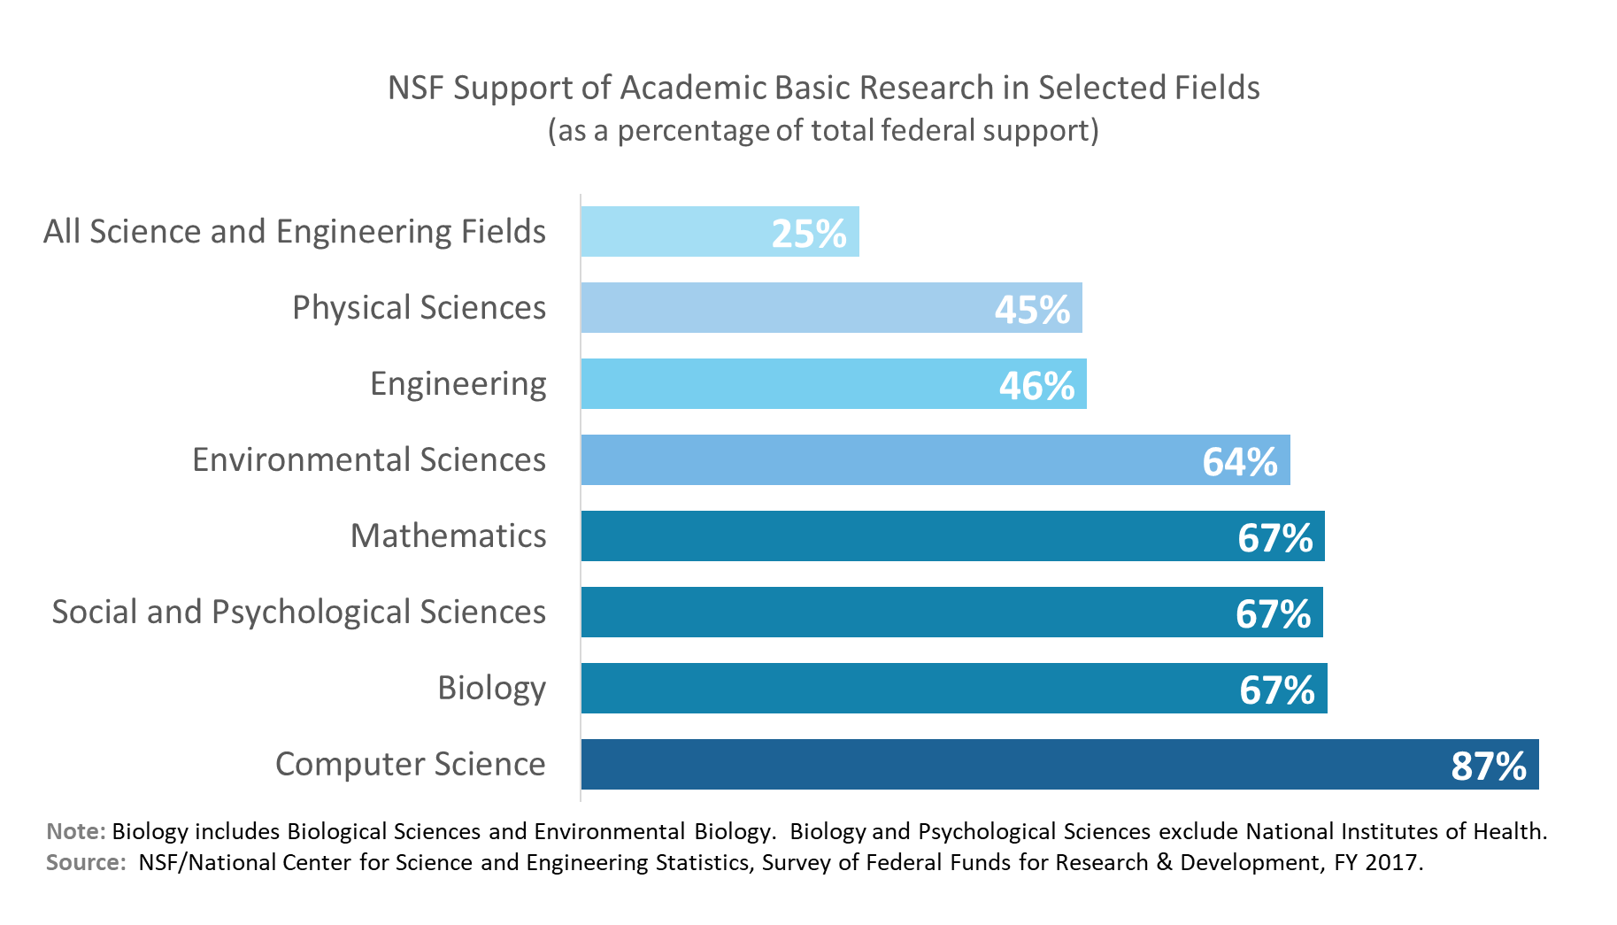
NSF provides significant support across scientific disciplines

Slide 6
NSF Budget, FY2010-2019
Billion
https://www.nsf.gov/about/budget/fy2020/index.jsp

Slide 7
ENG and SBIR/STTR Budgets
Notes:
7
FY 2019 CP numbers from Darren, September 2019

Slide 8
Electrical, Communications and Cyber Systems (ECCS) Division
Research Clusters
Communications, and Cyber Systems
(ECCS)
Electrical,
Communications,
and Cyber Systems
(ECCS)
Division Director Filbert Bartoli
Communications, Circuits, and Sensing Systems (CCSS)
Electronics, Photonics, and Magnetic Devices (EPMD)
Energy, Power, Controls and Networks (EPCN)

Slide 9
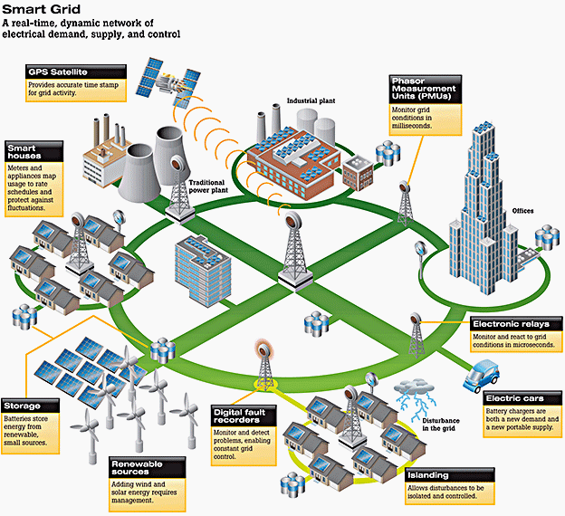
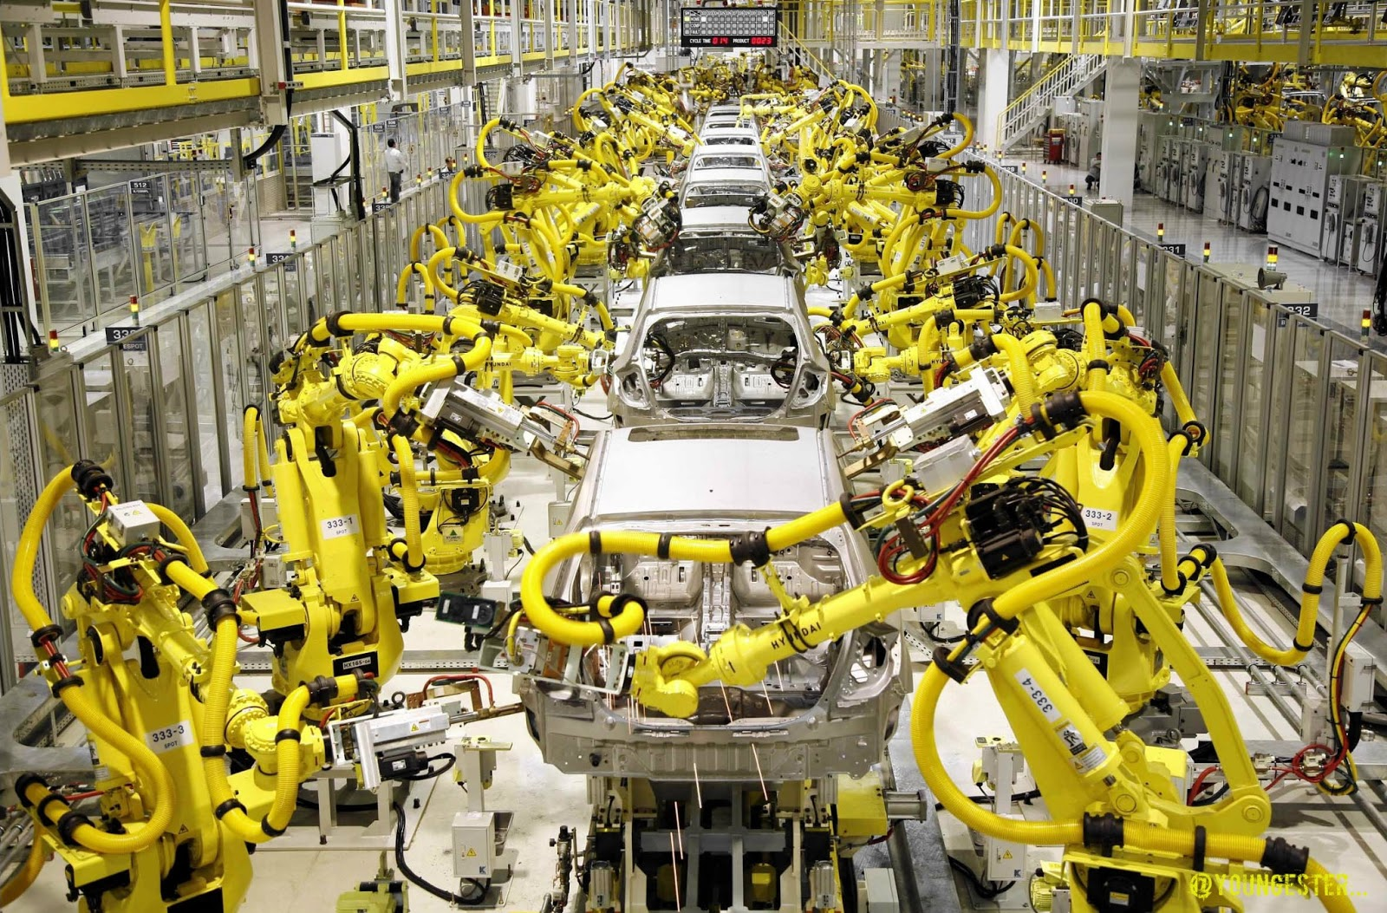
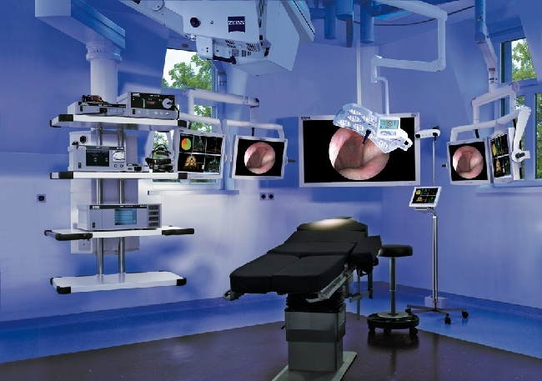
EPCN Program Role and Priorities
Foundational research in systems and control:
  modeling, analysis, design, optimization, learning, adaptation, and control
Massive data, real-time decisions
Networked and controlled at multi- and extreme scales
Dynamically reorganizing/reconfiguring
Dependable operation with high assurance
  reliability, safety, cybersecurity, and usability

Slide 10
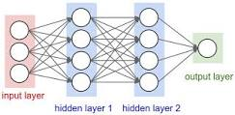
EPCN Program Focus
Control and Networked Systems (Baheti)
  Systems with both discrete and continuous dynamics
  Distributed decisions and actions with local information
  Scalable, faster, distributed computation algorithms
  Cyber-Physical security of control systems
Learning and Adaptive Systems (Kuh)
  Data analytics and Intelligent systems
  Machine learning algorithms (deep learning)
  Neural networks architectures and applications

Slide 11
EPCN Program Focus
Energy and Power Systems (Pahwa)
  Integration of solar, wind, storage with grid
  Monitoring, protection, and resilient operation
  Cyber security, market design, consumer behavior
  Microgrid, Energy efficient buildings
Advanced Power Electronics (Khaligh)
  Energy efficient power electronics converters
  Electric and hybrid vehicles
  Storage devices, Electric Machines
  Energy Harvesting

Slide 12
Cyber-Physical Systems (CPS)
Application Sectors
Abstract from application sectors to more foundational principles
Apply these principles to problems in new sectors
Safe, secure, reliable, verification, real-time adaptation….
energy
aeronautics
agriculture
Core Science,
Technology,
Engineering
Safety
Control
Verification
automotive
manufacturing
Real-time
Systems
Networking
medical
Security
civil
chemical
materials

Slide 13

Smart and Connected Communities Program
Community Impact
Fundamental Science and Engineering
Fundamental science and engineering research questions that must be addressed for community impact?
Universities, in partnerships with community stakeholders, have a key role in enabling Smart and Connected Communities of the future
Solicitation 19-564
  S&CC Integrative Research Grants (SCC-IRGs) Tracks 1 and 2
    Due Dates: LOI – Aug 6; Full Proposal – September 6
  S&CC Planning Grants (SCC-PGs)
Notes:
The solicitation supports research and research
capacity-building activities that integrate multiple disciplinary and stakeholder perspectives and undertake meaningful community engagement.

Slide 14
Sustainable Urban Systems
Research Networks
27 workshops and conferences in summer 2019 to explore concepts for advancing Sustainable Urban Systems Research Networks
  Small to mega cities
  Topics: food, resilience, infrastructure, automation, education, and others
  Regions: Great Lakes, Southeast, arid regions, and others
https://www.nsf.gov/ere/ereweb/urbansystems/
NSF AdCom for Environmental Research & Education
Notes:
The last workshop is Sept. 19-20,
Education for a New Sustainable Urban Systems Science: Designing a New Curriculum Integrating Sustainability Science and Urban Science
Collaboration between ENG, BIO, CISE, EHR, GEO, SBE, OIA, and OISE
Urban areas are centers of innovation that generate more than 80% of the global Gross Domestic Product (GDP), and will house nearly 66% of the world’s population by the year 2050, almost doubling our current urban population in a very short time. This scale and pace of urbanization has never before been seen in human history. At the same time, urban areas are focal points of some of the world’s most complex challenges, and hence also offer the promise of transformative solutions. The urban sustainability challenge impacts both people and the planet at unprecedented levels, and from local to global scales. The scale, complexity, and transboundary aspects of the urban era is an emerging area of inquiry where scientific advancement is urgently needed.
Report is at https://www.nsf.gov/ere/ereweb/ac-ere/sustainable-urban-systems.pdf

Slide 15
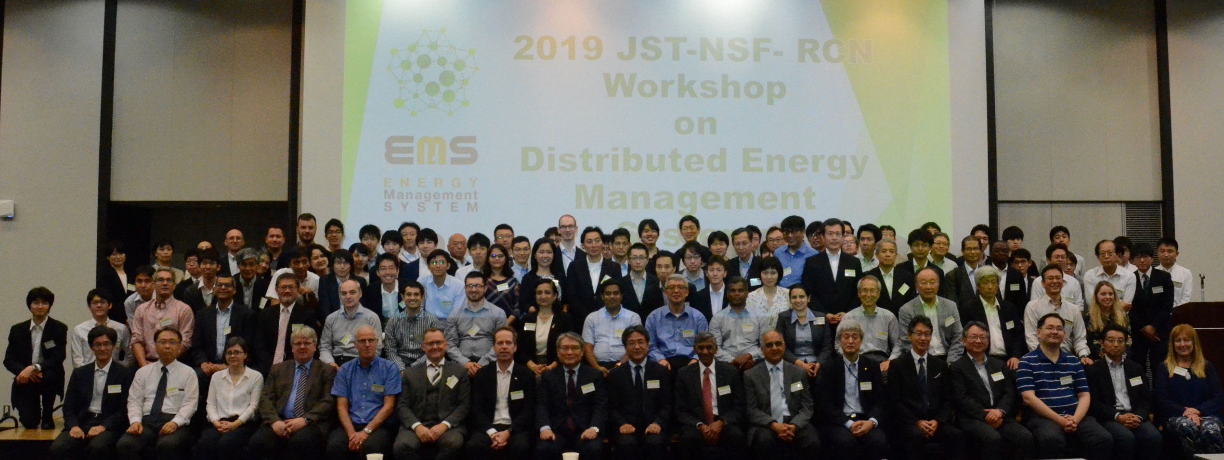
JST-NSF-RCN Workshop: Tokyo, June 2019
Image Credit: Anil Pahwa

Slide 16

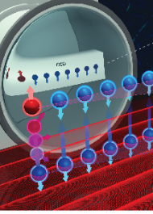
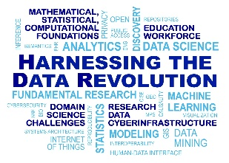
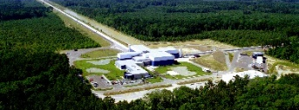
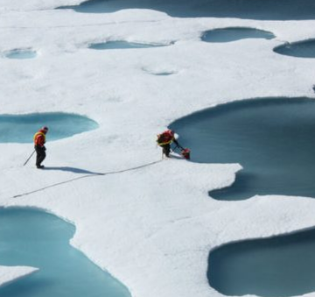
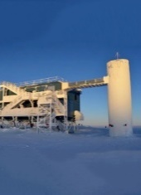
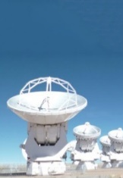


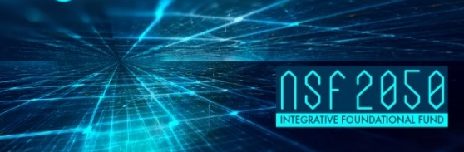
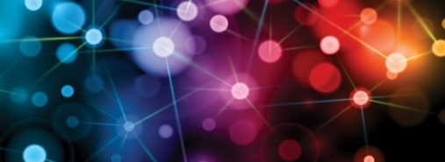

NSF “10 Big Ideas”
RESEARCH IDEAS
Work at the
Human-Technology
Frontier: Shaping the Future
Windows on the Universe:
The Era of Multi-messenger Astrophysics
The Quantum Leap:
Leading the Next Quantum Revolution
Harnessing Data for 21st Century Science and Engineering
Navigating the
New Arctic
Understanding the Rules of Life:
Predicting Phenotype
PROCESS IDEAS
Mid-scale Research Infrastructure
NSF 2050: Seeding Innovation
Growing Convergent Research at NSF
NSF-INCLUDES: Enhancing Science and Engineering through Diversity
2

Slide 17
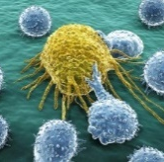
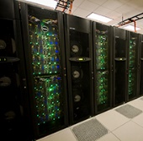
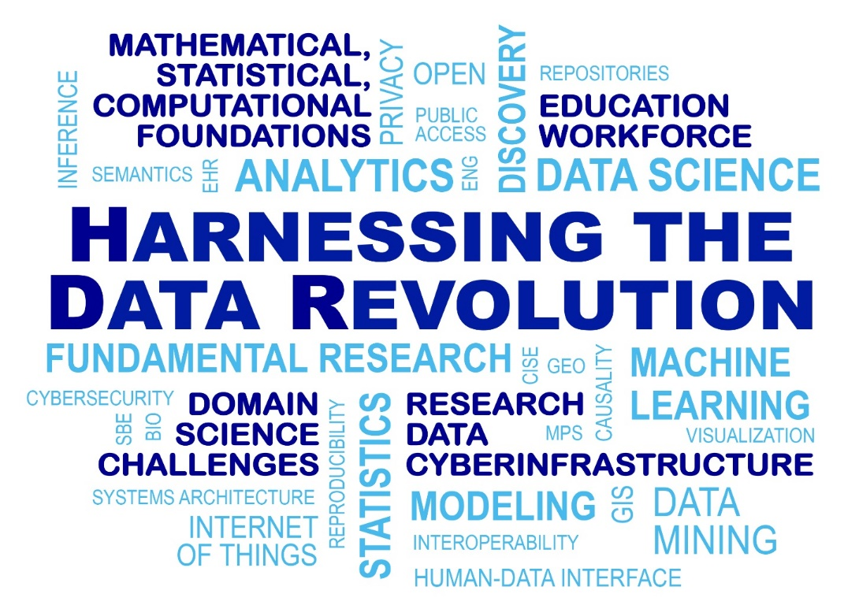





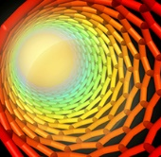





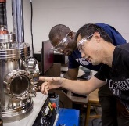




BIO
CISE
EHR
ENG
GEO
MPS
SBE
OIA
OISE
Directorates, Offices
Big Ideas
Notes:
Appropriate that we start with HDR, following convergence – every single directorate and office involved, and data science and infrastructure is a key part of each and every Big Idea.

Slide 18

Next Generation Power Systems
Digital Grid
  Rise of distributed generation (DG) and microgrids
  Increasing penetration of renewable resources (wind and solar
  Changing demand profiles and consumer expectations
  Need for resilient grid operation in the face of natural and man-made disasters
  Extensive deployment of sensing, communications and information technologies
  Massive data and real-time decisions
  Cybersecurity of power grid
  Integration of power electronics for power system operations

Slide 19
Workshop Goals
Bring experts from control systems, power electronics, and power systems together to identify fundamental challenges for control of power electronics-enabled power systems,
Enhanced grid stability, autonomy, scalability, operability, reliability, security, and resiliency,
Strengthen collaborative efforts to tackle the challenges identified,
Raise the awareness of funding agencies and policy-makers to support and nurture research and educational activities to advance fundamental knowledge, enabling technologies, and workforce in this area,
A report addressing identified issues to advance research on the subject

Slide 20
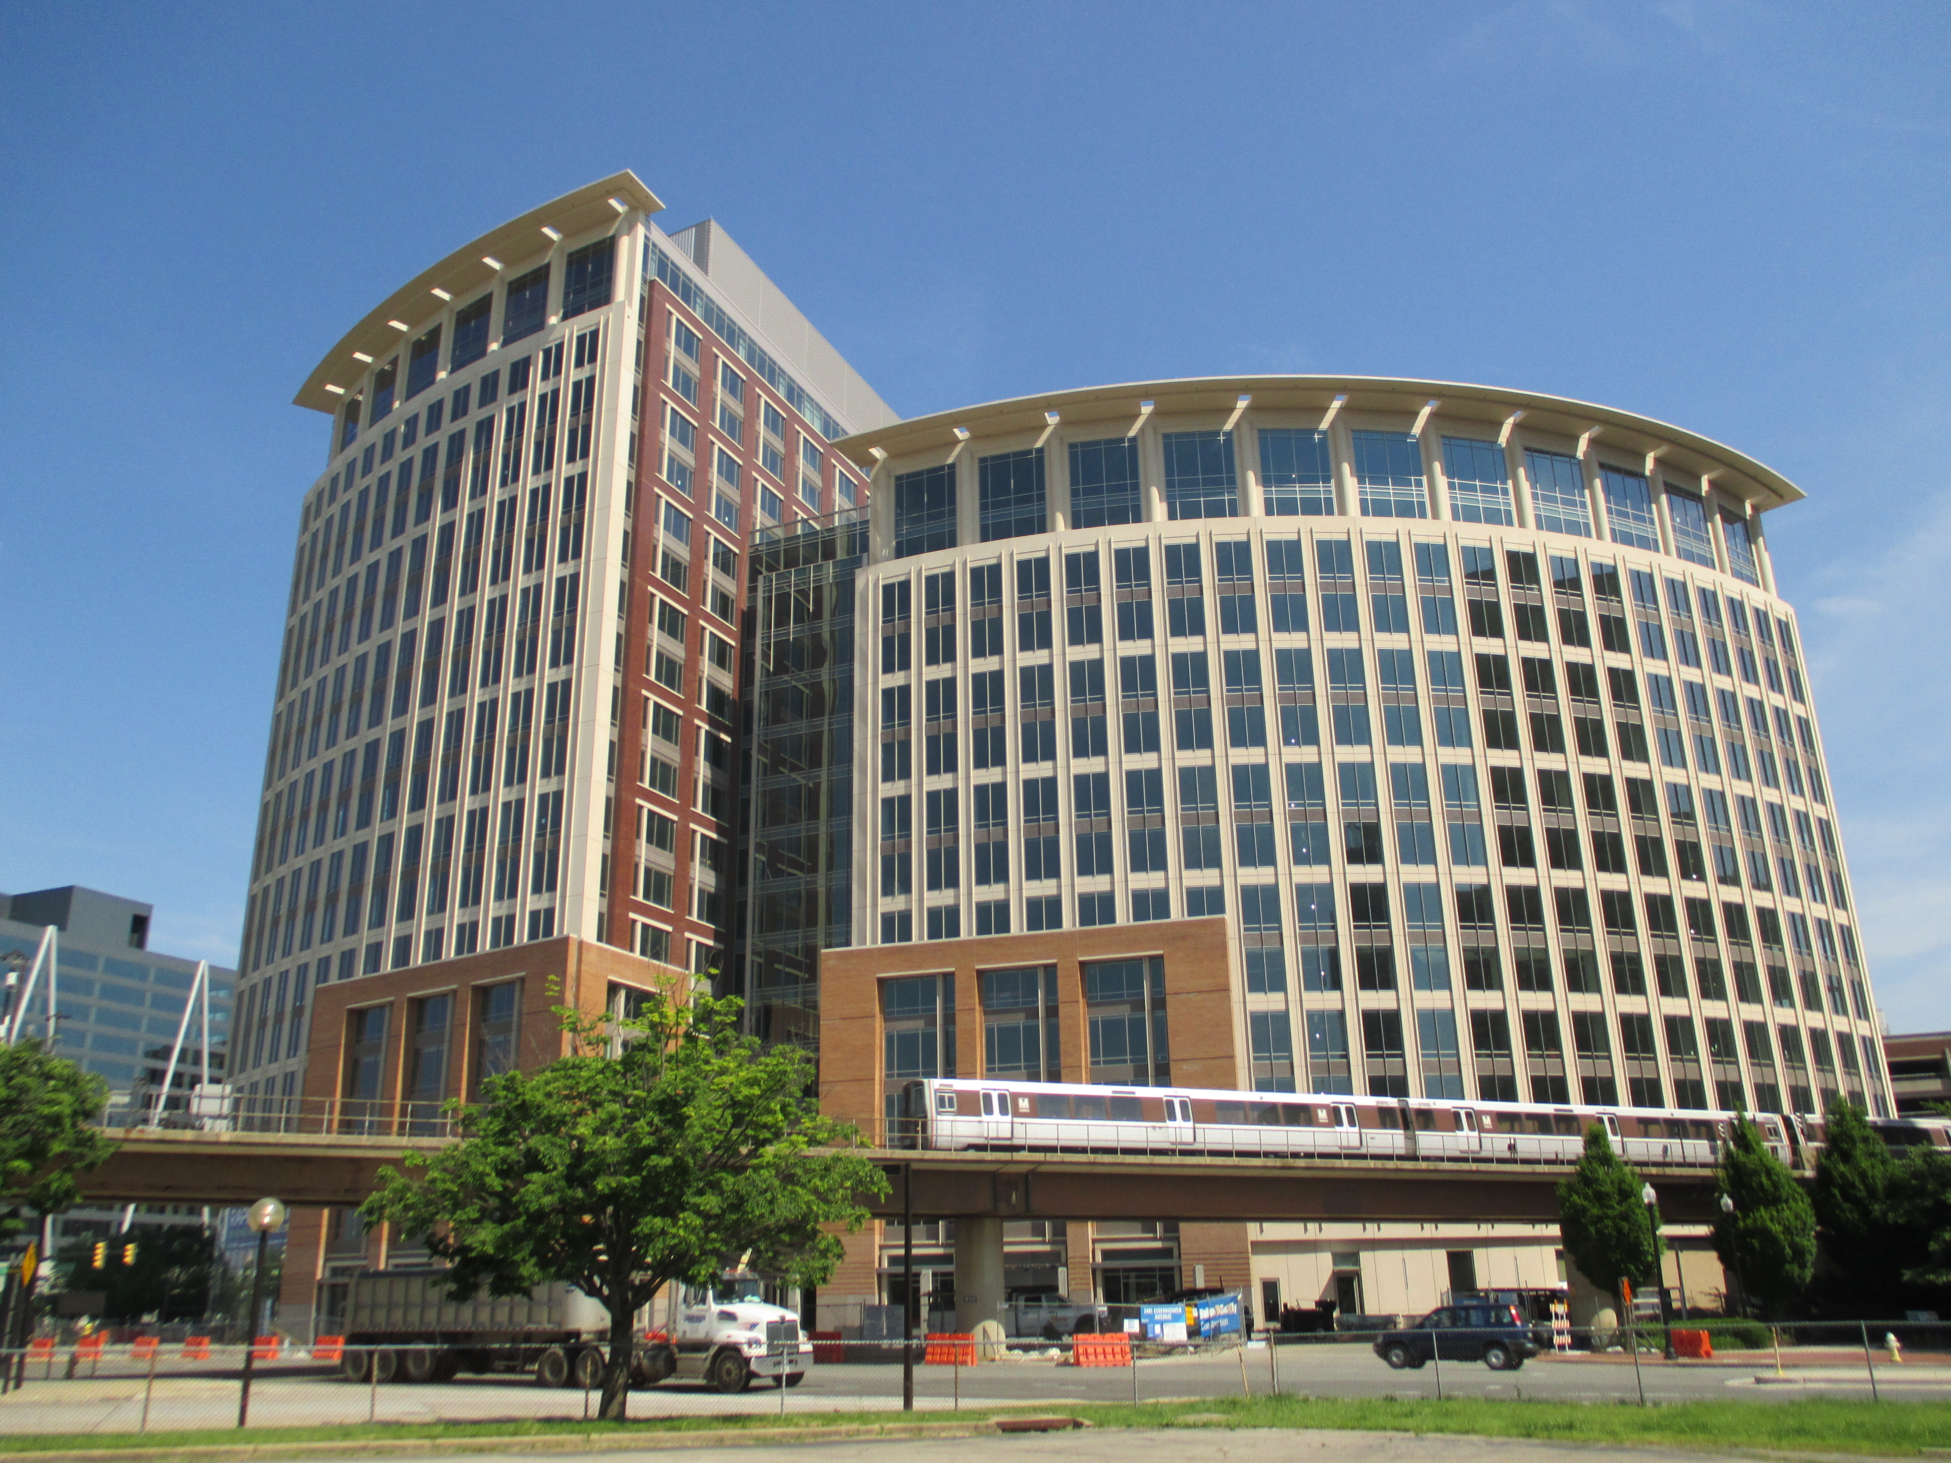
Thank You !!!
Contact Information:
Email:
apahwa@nsf.gov
akhaligh@nsf.gov
rbaheti@nsf.gov
akuh@nsf.gov

